Slide 1

Fast, Accurate, and Lightweight Super-Resolution with Cascading Residual Network
Ziyang Chen (u6908560), Han Zhang (u7235649)
Australian National University
01/11/2021

Slide 2

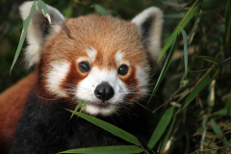

Introduction
Super-Resolution: Reconstructing the High-Resolution (HR) image from a Low-Resolution (LR) image.
More pixels
More details
Clearer

Slide 3
Related Work
SCRNN
Outperformed traditional algorithm
More operations in comparing in depth
FSRCNN and ESPCN
Fewer operations
Performance depends on the number of layers
Poor management in multi-scale training
SqueezeNet
AlexNet-based architecture
50X fewer parameters
More efficient

Slide 4
Cascading Residual Network (CARN or CARN-M)
X2
X3
Conv
Shuffle X2
Conv
Shuffle X2
Cascading Block
Cascading Block
Cascading Block
conv
1X1 conv
1X1 conv
Residual Block
1X1 conv
conv
Residual Block
Residual Block
Residual Block
Residual Block
Residual Block
Residual Block
Residual Block
Residual Block
Conv
Shuffle X2
Conv
Shuffle X2
X4
Cascading Residual Network
Plain ResNet

Slide 5
Cascading Residual Network (CARN or CARN-M)
Input
Input
Input
Residual (-E)
Conv
Group Conv
1X1 Conv
ReLU
ReLU
Cascading Block
Residual (-E)
Group Conv
1X1 Conv
ReLU
Conv
1X1 Conv
Residual (-E)
ReLU
1X1 Conv
ReLU
Output
Output
Output
Residual Block
(CARN)
Residual-E Block
(CARN-M)
Cascading Block

Slide 6
Cascading Residual Network (CARN or CARN-M)
X2
X3
Conv
Shuffle X2
Conv
Shuffle X2
Cascading Block
Cascading Block
Cascading Block
conv
1X1 conv
1X1 conv
1X1 conv
conv
Conv
Shuffle X2
Conv
Shuffle X2
X4
Advantages:
Global and local connection.
The model combines features from multiple layers, which can learn multiple information.
Quickly propagate information from lower to higher layers.

Slide 7
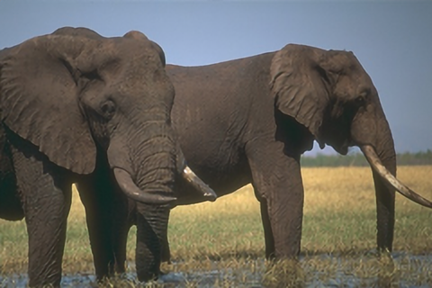
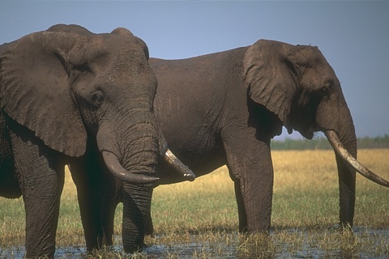


Performance (CARN)
SR (X2)
Data preprocessing:
RGB version
Random horizontal flip
90 degrees rotation
HR
SR (X3)
Training Conditions:
patch size = 64
Batch size = 64
L1 loss function
Adam optimizer
Learning rate = 0.0001(decay = 400000)
epsilon = 10e-8
Steps = 600000
SR (X4)

Slide 8



Performance (CARN-M)
SR (X2)
Data preprocessing:
RGB version
Random horizontal flip
90 degrees rotation
HR
SR (X3)
Training Conditions:
patch size = 64
Batch size = 64
Group = 4
L1 loss function
Adam optimizer
Learning rate = 0.0001(decay = 400000)
epsilon = 10e-8
Steps = 600000
SR (X4)

Slide 9
Performance Comparison (CARN and CARN-M)
Scale | CARN (PSNR/SSIM) | CARN-M (PSNR/SSIM)
X2 | (32.39/0.89) | (32.63/0.89)
X3 | (29.71/0.80) | (29.65/0.79)
X4 | (29.83/0.77) | (28.12/0.71)
PSNR: Peak Signal-to-Noise Ratio
SSIM: Structural Similarity

Slide 10
Performance Comparison (Loss function)
Based on CARN
Dataset | LR (PSNR/SSIM) | L1 Loss (PSNR/SSIM) | MSE Loss (PSNR/SSIM) | SmoothL1 Loss (PSNR/SSIM)
Set5 | 25.86/0.7639 | 29.87/0.8713 | 29.79/0.8696 | 29.75/0.8704
Set14 | 23.72/0.6584 | 26.32/0.7609 | 26.32/0.7591 | 26.27/0.7593
Urban100 | 21.25/0.6248 | 24.24/0.7694 | 24.24/0.7671 | 24.23/0.7681
B100 | 24.24/0.6359 | 26.12/0.7308 | 26.12/0.7296 | 26.10/0.7299
Unnatural | 23.56/0.6788 | 24.34/0.7367 | 24.34/0.7309 | 24.27/0.7331

Slide 11
Performance Comparison (dataset)
Scale | Dataset | LR (PSNR/SSIM) | CARN (PSNR/SSIM) | CARN-M (PSNR/SSIM)
X2 | B100 | 27.37/0.8110 | 30.02/0.8939 | 30.56/0.8985
 | Urban100 | 24.53/0.8061 | 30.28/0.9232 | 29.64/0.9163
 | Set5 | 30.44/0.8982 | 35.61/0.9494 | 35.32/0.9473
 | Set14 | 27.32/0.8264 | 31.23/0.9036 | 31.02/0.9009
 | Unnatural | 25.50/0.7834 | 25.76/0.8063 | 25.82/0.8080
Red: highest
Blue: lowest
Scale | Dataset | LR (PSNR/SSIM) | CARN (PSNR/SSIM) | CARN-M (PSNR/SSIM)
X3 | B100 | 25.47/0.7170 | 27.73/0.8066 | 27.57/0.8033
 | Urban100 | 22.57/0.7114 | 26.50/0.8462 | 26.01/0.8354
 | Set5 | 27.80/0.8347 | 32.23/0.9125 | 31.95/0.9096
 | Set14 | 25.20/0.7395 | 28.14/0.8275 | 27.91/0.8233
 | Unnatural | 24.43/0.7267 | 25.09/0.7764 | 25.20/0.7771
Scale | Dataset | LR (PSNR/SSIM) | CARN (PSNR/SSIM) | CARN-M (PSNR/SSIM)
X4 | B100 | 24.24/0.6359 | 26.26/0.7336 | 24.63/0.6653
 | Urban100 | 21.25/0.6248 | 24.55/0.7793 | 23.44/0.7305
 | Set5 | 25.86/0.7639 | 30.12/0.8764 | 29.84/0.8709
 | Set14 | 23.72/0.6584 | 26.50/0.7645 | 26.27/0.7595
 | Unnatural | 23.56/0.6788 | 24.47/0.7382 | 23.92/0.7224

Slide 12
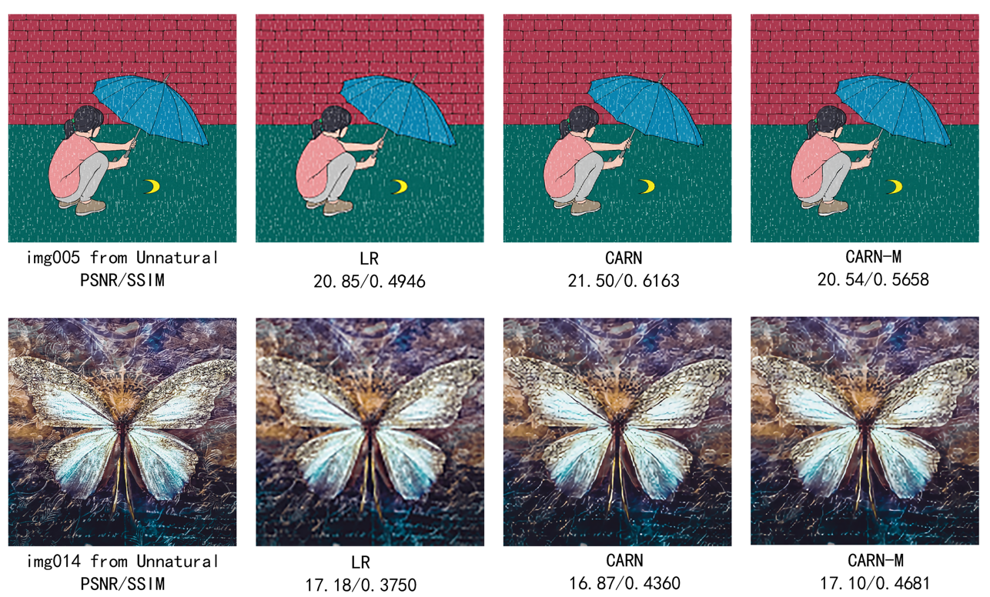
Performance Comparison (dataset)
Performance on unnatural images

Slide 13
Conclusion
Implement two models: CARN and CARN-M, to achieve super resolution task.
L1 is the most suitable loss function than others.
CARN has the better performance than CARN-M in the majority of the datasets.
Future Work
add unnatural images and more types of natural images to the training set to enhance the versatility and performance of the model
apply this network to video SR tasks and consider the time correlation of multiple frames to enhance network performance.

Slide 14
References
Ahn, N., Kang, B., & Sohn, K.-A. (2018). Fast, accurate, and lightweight super-resolution with cascading residual network. Computer Vision – ECCV 2018, 256–272. https://doi.org/10.1007/978-3-030-01249-6_16.
Datasets
DIV2K Dataset. https://data.vision.ee.ethz.ch/cvl/DIV2K/.

